Slide 1
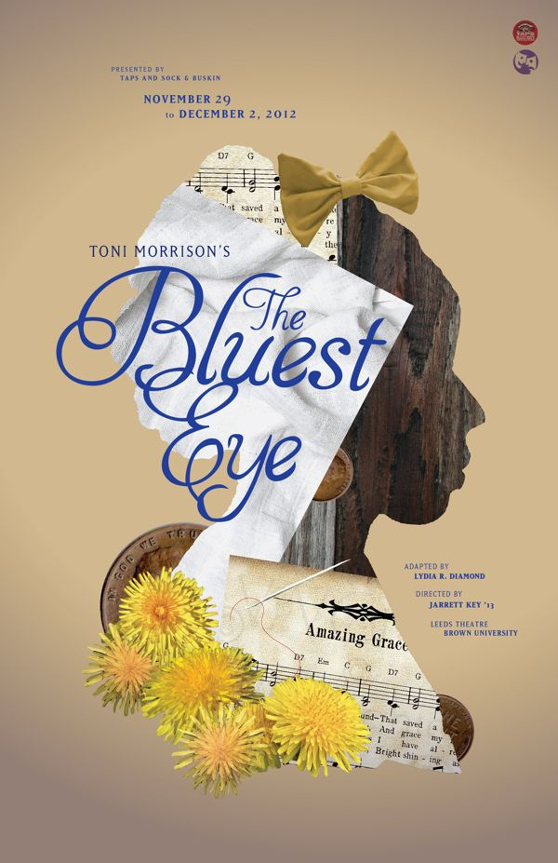
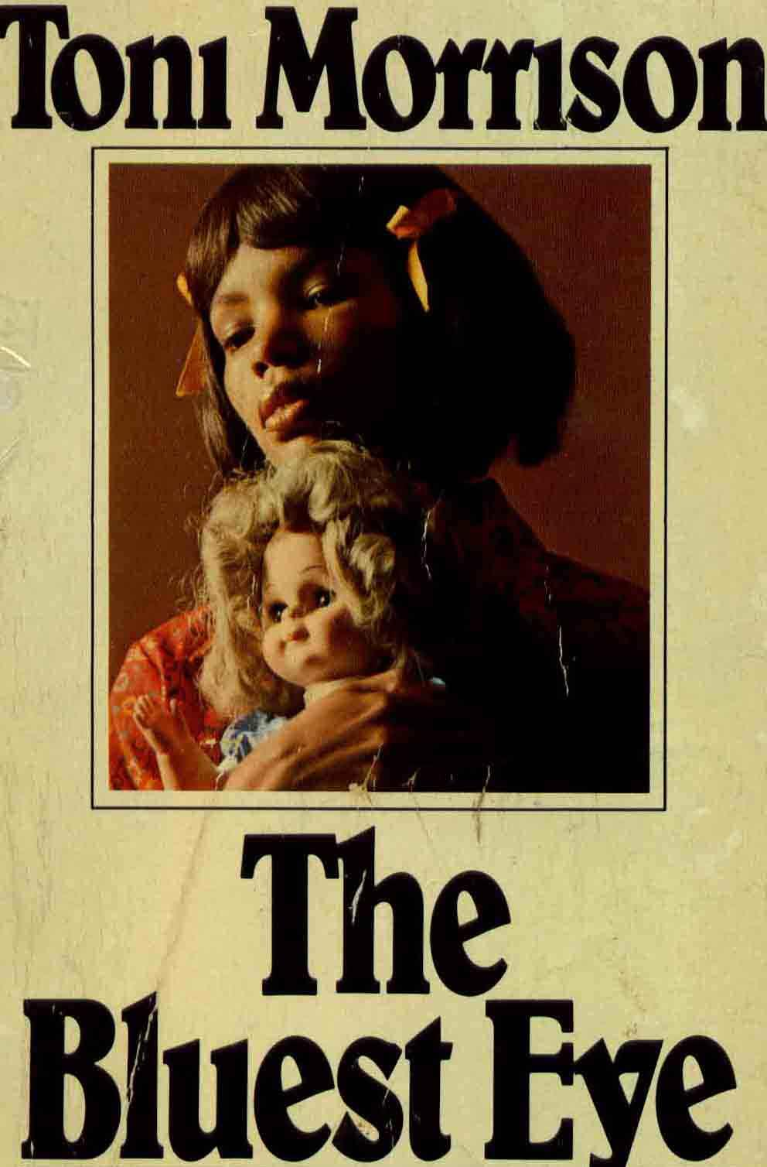
Polly from The Bluest Eye
By Bella Sekona, Chris Blyskal, Gen Wiley, Caleb Dawson, and Rob Wood

Slide 2
Internalized Oppression
When members of of a marginalized groups feel obligated to act out or buy into the stereotypes that the dominant culture sets for them.

Slide 3
How Internalized Oppression is shown
Pauline watches films that make her realize that every face should be categorized on a scale of absolute beauty.
Pauline’s family is extremely poor and their poverty strips them from their human worth leaving them vulnerable to the upper class.
Pauline tries to be a good servant because that is what society limits a black woman to.

Slide 4
Textual Evidence
“She was never able, after her education in the movies, to look at a face and not assign it some category in the scale of absolute beauty, and the scale was one she absorbed in full from the silver screen” (Morrison 122).
“The Breedloves did not live in a storefront because they were having temporary difficulty adjusting to the cutbacks at the plant. They lived there because they were poor and black, and they stayed there because they believed they were ugly” (Morrison 38).
“‘We’ll never let her go. We could never find anybody like Polly. She will not leave the kitchen until everything is in order. Really, she is the ideal servant’” (Morrison 128).

Slide 5
Analysis of Evidence
Because she does not match up with the images of beauty portrayed in popular media, Polly feels inadequate. Most people who were described as beautiful were those of the dominant culture which was white. Because there were not many women of color characterized as beautiful, Polly feels as if she cannot he beautiful as well.
Due to their socioeconomic status they live in poverty and they stayed there because society perceives them as ugly. They felt that they were ugly, so they stayed in a ugly household.
Polly is living within the boundaries society has set for a black woman, as she is a servant. No matter how hard she works, she will never be anything more than just that.

Slide 6
Conclusion about the author’s intentions
Internalized oppression is malignant because it is often unconscious but also divisive.
Makes lives tougher for people due to unconscious expectations, stereotypes, etc. which create anger, envy, and unnecessary disputes

