Slide 1
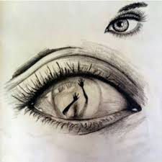
Internalized Oppression: Pecola
By: Gisselle Munguia, David Watts, Erica Ordaz and Clinton Pugh

Slide 2
Definition
Translating dominant people’s perspective of you into self-hate and believing you must change your identity in order to escape oppression.

Slide 3
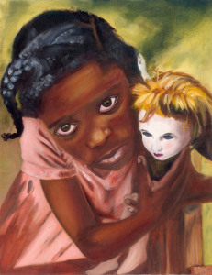
“It had occurred to pecola some time ago that if her eyes, those eyes that held the pictures, and knew the sights- if those eyes of hers were different, that is to say, beautiful, she herself would be different.”(Morrison 27)
“Thrown, in this way, into the binding conviction that only a miracle could relieve her, she would never know her beauty. She would only see what there was to see: the eyes of other people” (Morrison 28)
“She eats the candy, its sweetness is good. To eat the candy is somehow to eat the eyes, eat Mary Jane. Love Mary Jane. Be Mary Jane.” (Morrison 30)

Slide 4
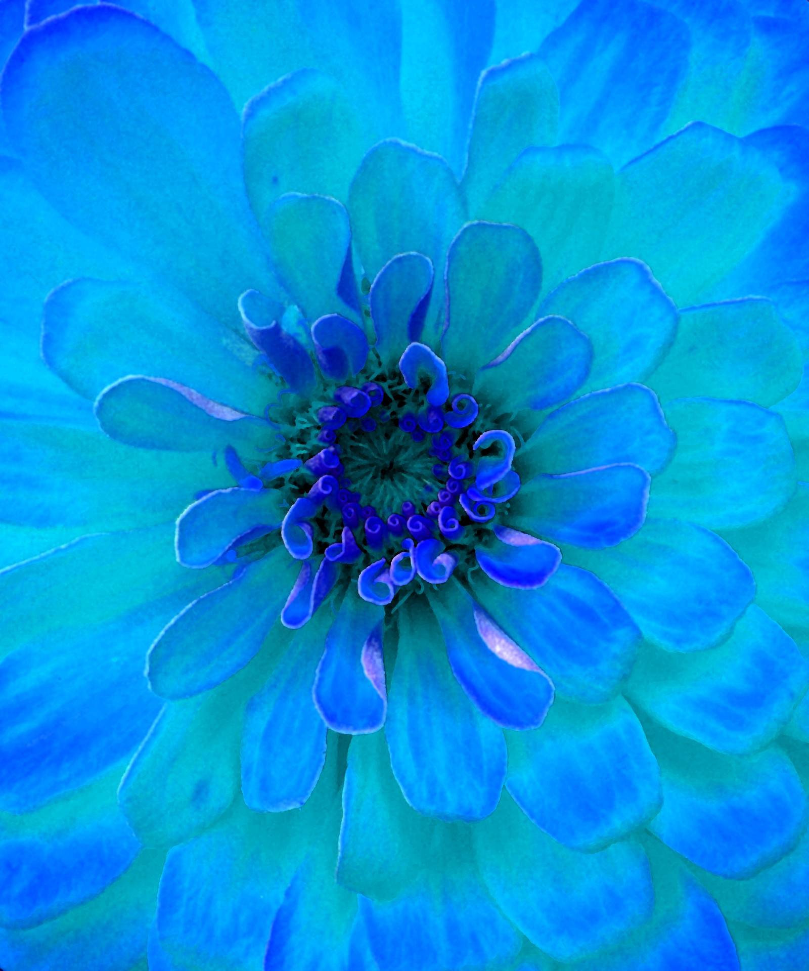
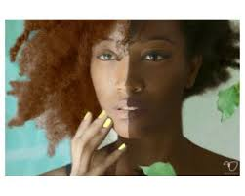
Pecola’s internalized oppression
Pecola's ideals on physical features such as eyes and skin color function as a weapon of internalized oppression because she was unable to love and accept herself for who she was so she began to hate herself and long for being someone “beautiful” externally even though Mary Jane, being the white dominant race is a contributor in why she is internally oppressed..Pecola not only wants blue eyes for the sake of adapting into white culture, she believes they can help her escape her reality, which is being broken down by those around her like her parents or the white oppressors.
Pecola spends most of her life waiting for the day she can possess these blue eyes.

Slide 5
What is the author’s larger message about systems of oppression ?
In a system of oppression, minorities are treated as lesser than; not being given equal rights, oppurtunities, and respect. There is a narrative that I am not enough, and to have true dignity one must transform himself into what this white supremacist society already loves. While Internalized oppression is insecurity because people on the outside see past your beauty, The author is bringing to light that other people’s perspective of you doesn’t define you.

Slide 6
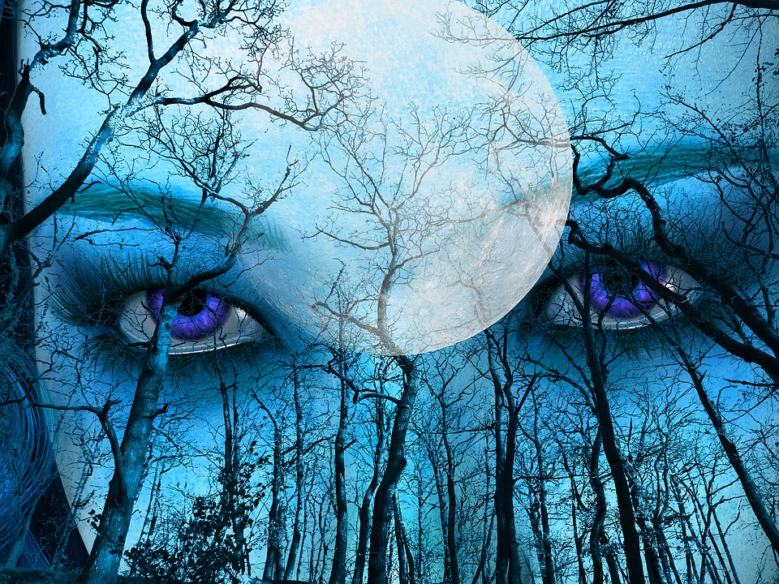
Thank You

