Slide 1
Internalized Oppression: Cholly
By Jordan, Neil, Thomas, and Dylan
Notes:
Jordan

Slide 2
Definition
Internalized oppression is the idea that one's thoughts and decisions are detrimental towards the well being of oneself and others, as a result of the hostile views of society.
Notes:
Dylan

Slide 3
Effect on Cholly
Cholly is in a constant struggle with his emotions because of the humiliation he faced when he was younger and the scrutiny his family goes through. He seems to not know how to express himself, so he takes his pain away by binge-drinking and hurting his loved ones.
Notes:
Dylan

Slide 4
Evidence
Context: The narrator is in between telling the reader that Cholly has come home drunk and describing his hate filled relationship with his wife.
“When he was still very young, Cholly had been surprised in some bushes by two white men while he was newly but earnestly engaged in eliciting sexual pleasure from a little country girl. The men had shone a flashlight right on his behind. He had stopped, terrified…’Go on,’ they said.’ Go on and finish. And, nigger, make it good.’... For some reason Cholly had not hated the white men…Even a half-remembrance of this episode, along with myriad other humiliations, defeats, and emasculations, could stir him into flights of depravity that surprised himself—but only himself” (Morrison, Autumn).
Notes:
Jordan

Slide 5
Evidence
Context: After the narrator describes the state of the Breedlove’s home as a place with no memories or life, she goes on to depict how this environment has convinced the Breedlove family of their own “ugliness” and how the father, Cholly, has embodied it as his behavior.
“The Breedloves...lived there because they were poor and black, and they stayed there because they believed they were ugly. Although their poverty was traditional and stultifying, it was not unique. But their ugliness was unique. No one could have convinced them that they were not relentlessly and aggressively ugly. Except for the father, Cholly, whose ugliness (the result of despair, dissipation, and violence directed toward petty things and weak people) was behavior...” (Morrison, Autumn).
Notes:
Neil’s Slide.

Slide 6
Evidence
Context: Before raping his daughter, Cholly portrays that he sees his daughter as weak and vulnerable
“His revulsion was a reaction to her young, helpless, hopeless presence...“Again the hatred mixed with tenderness. The hatred would not let him pick her up, the tenderness forced him to cover her. So when the child regained consciousness, she was lying on the kitchen floor under a heavy quilt, trying to connect the pain between her legs with the face of her mother looming over her”(Morrison, Spring).
Notes:
Thomas SLIDE

Slide 7
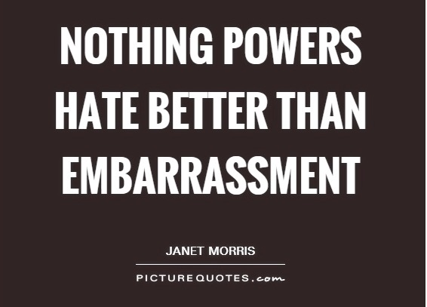
Analysis
A lot of experiences of oppression have worn Cholly down
He keeps the experience to himself, but gives his pain to others
A sense of humiliation and embarrassment
-
- Embarrassed, tries to be like his oppressors to people
who were/are like him
- He raped his daughter and passed his pain down to
someone he is supposed to love
He has relationships with his family and abuse of
alcohol
Notes:
Dylan

Slide 8
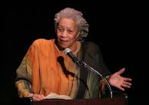
CONCLUSION….
Being oppressed causes the victim to become the oppressor
Internalized oppression is passed down through generations
Becomes vicious cycle
Notes:
Thomas slide

